Slide 1
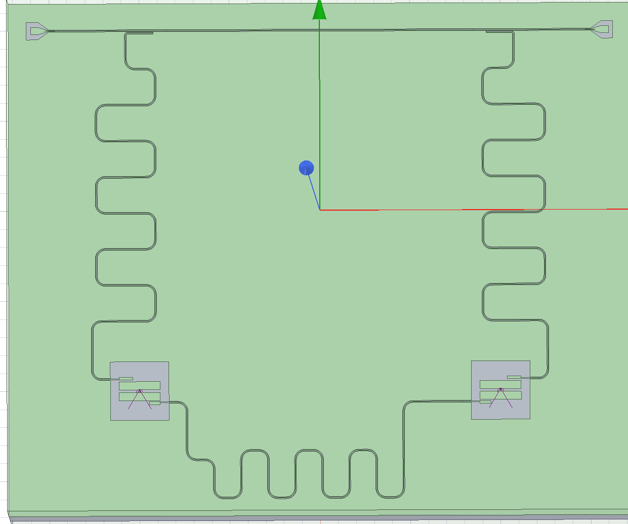
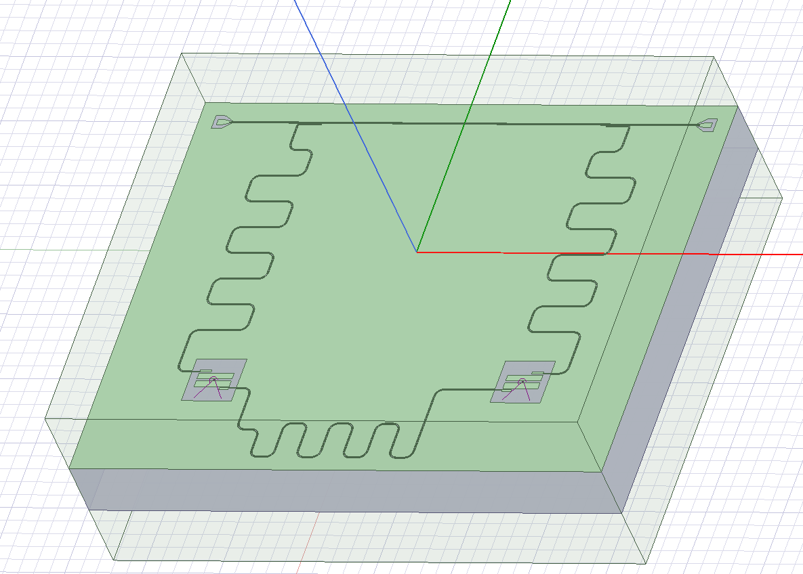
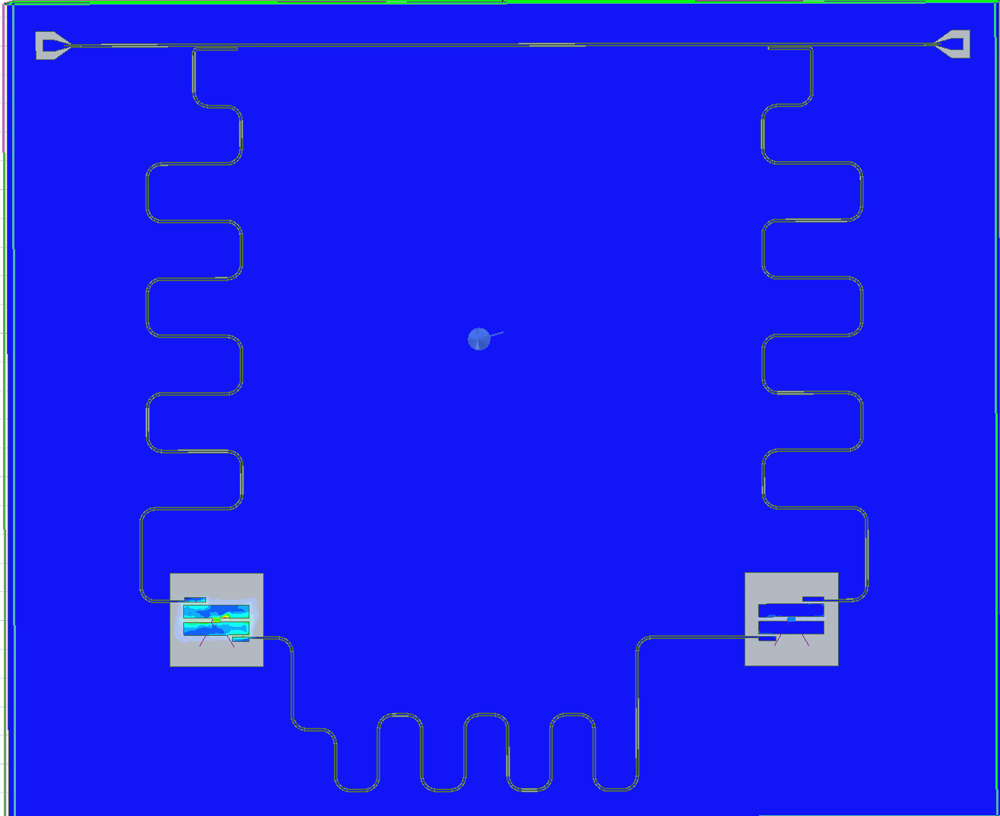
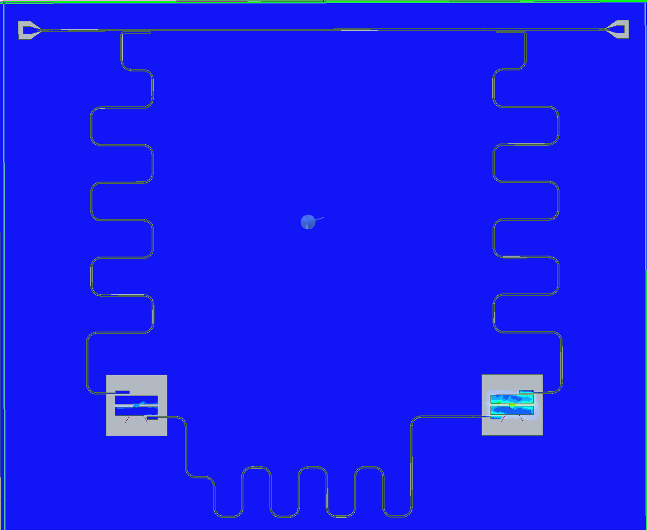
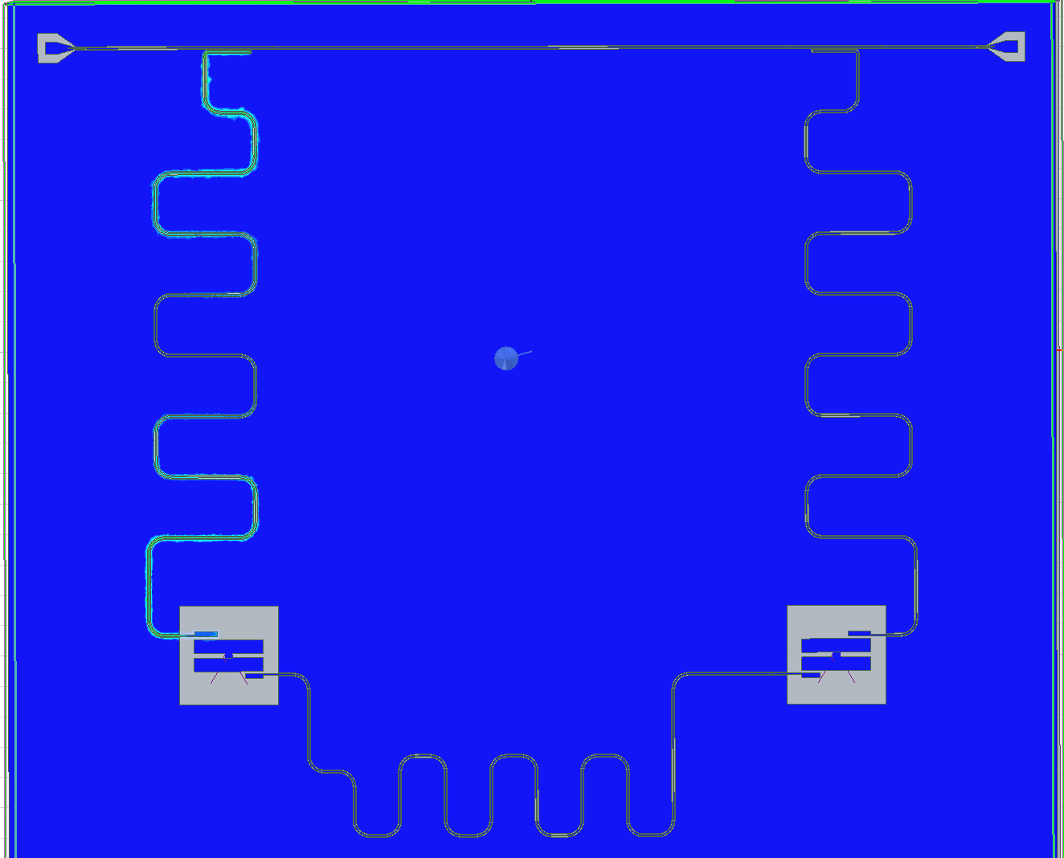
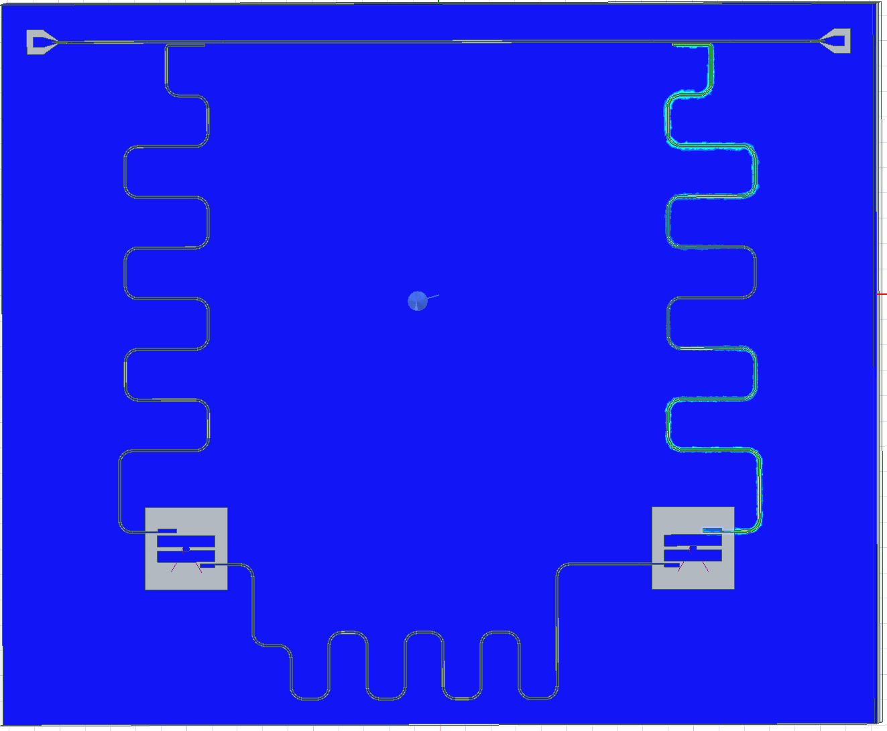
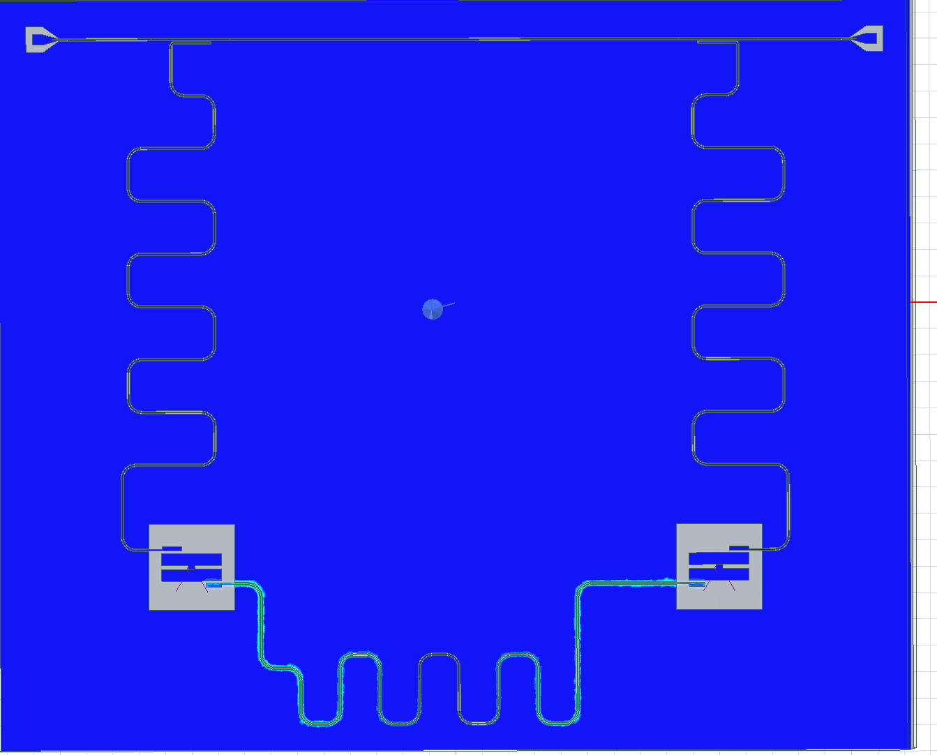
Planarchip – EPR Analysis
Q0 : 5.36GHz
Q1 : 5.38GHz
Rr0 : 6.82GHz
Rr1 : 6.64GHz
Bus: 7.26GHz

Slide 2
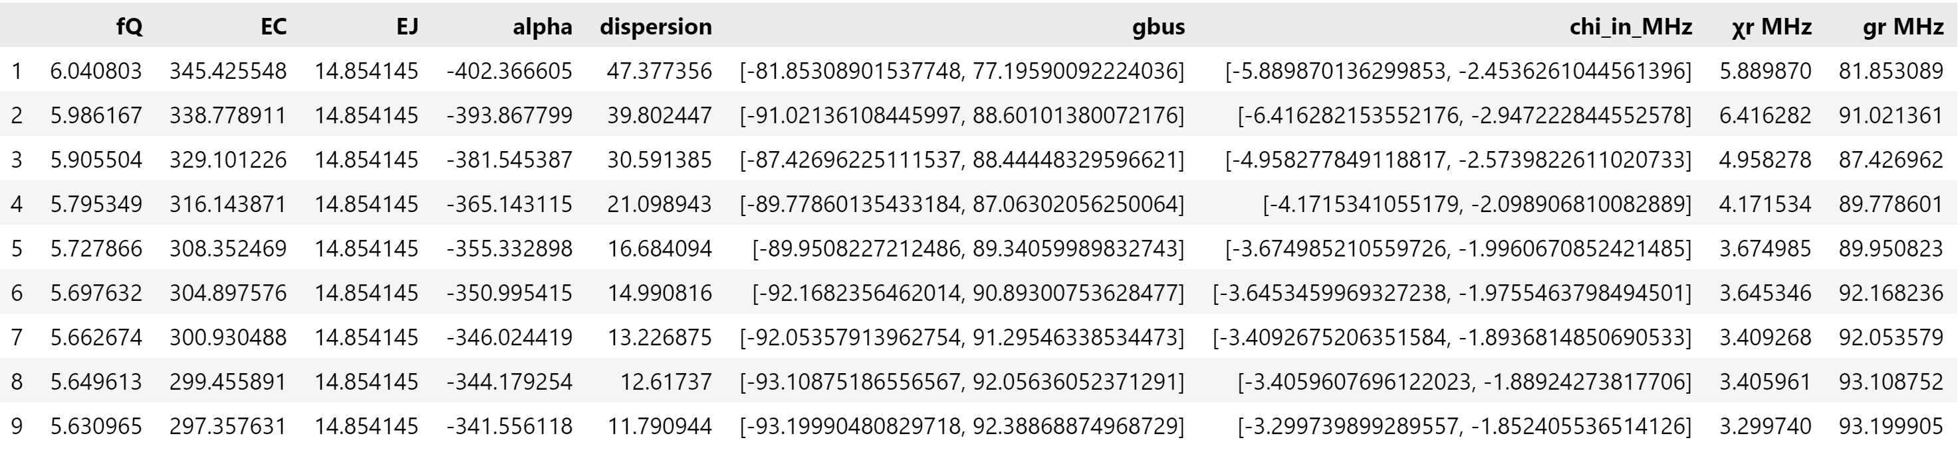
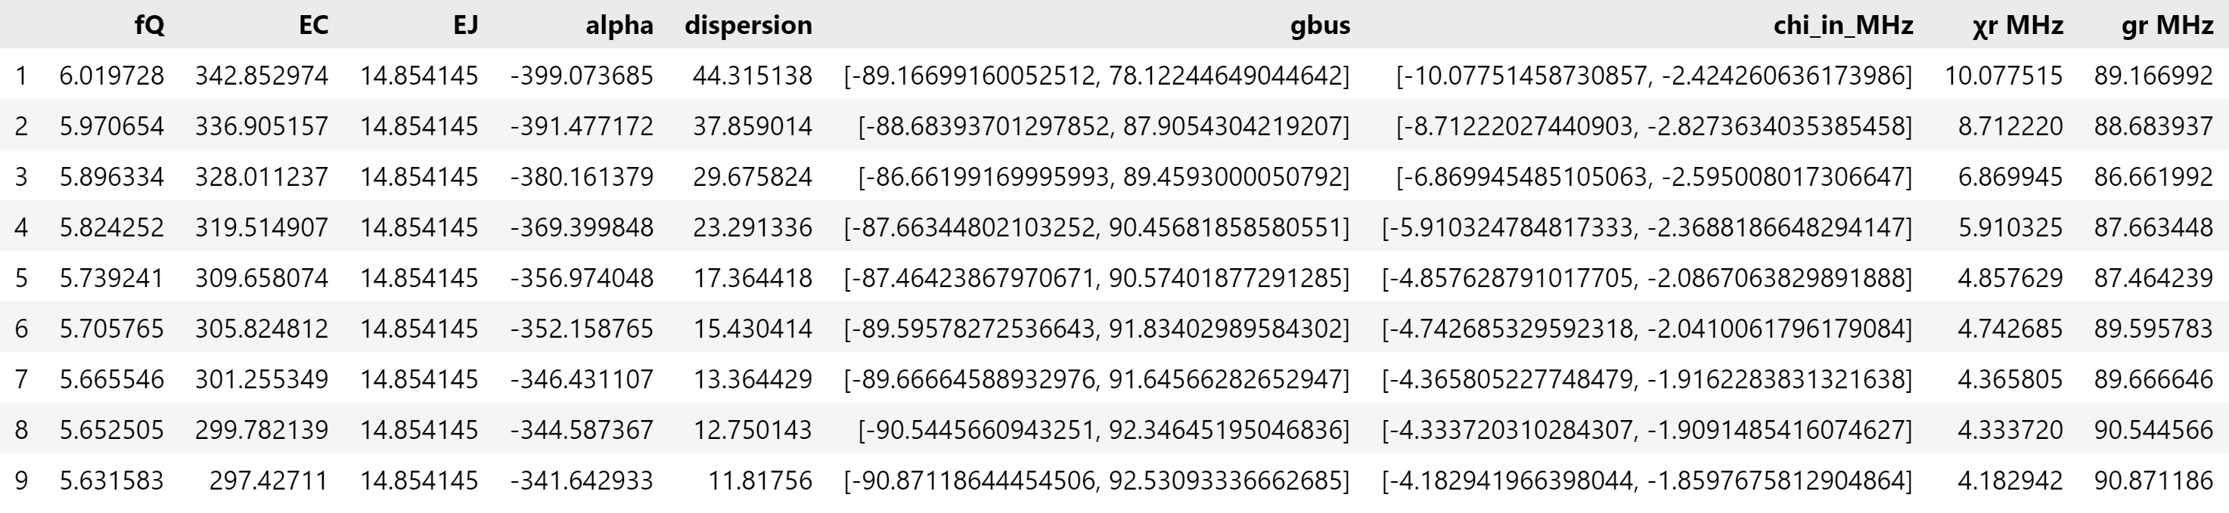
Planarchip – LOM Analysis
Q0
Q1

Slide 3
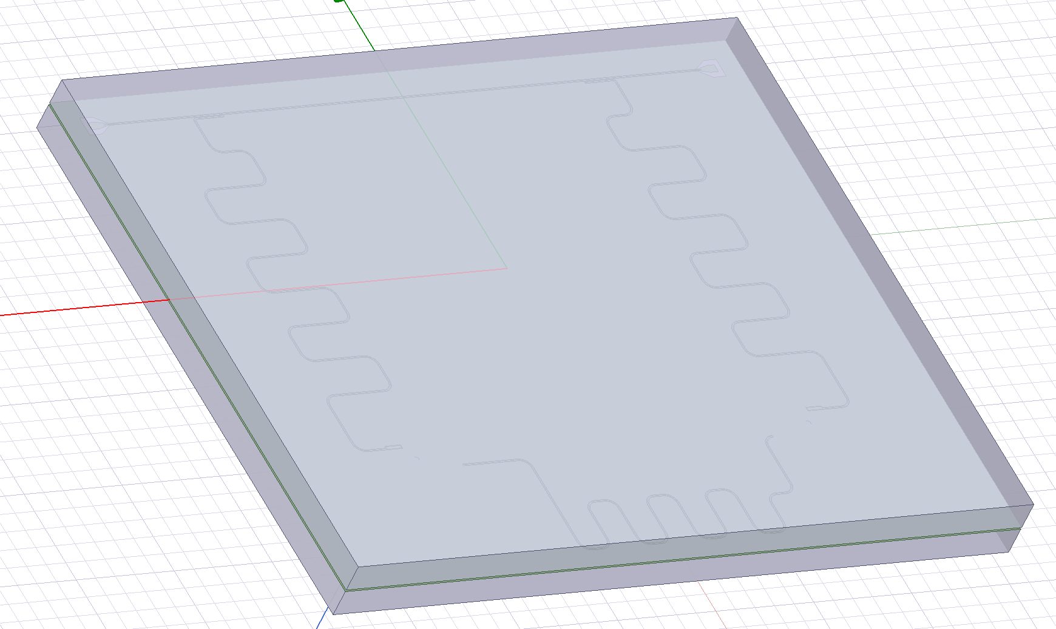
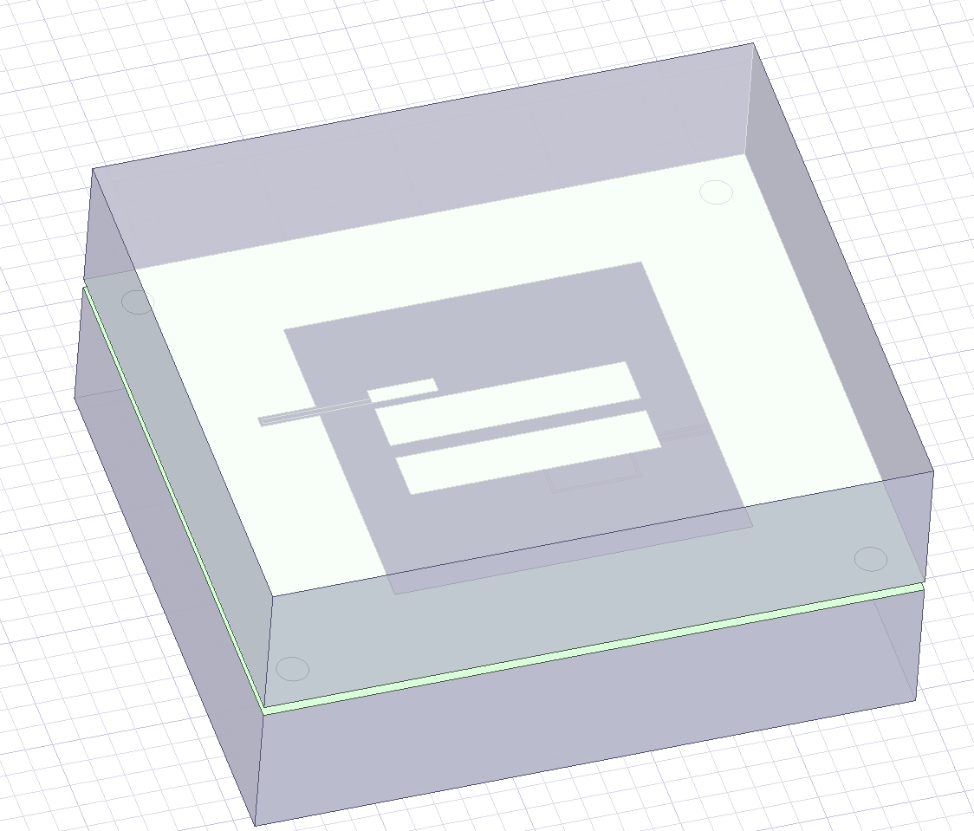
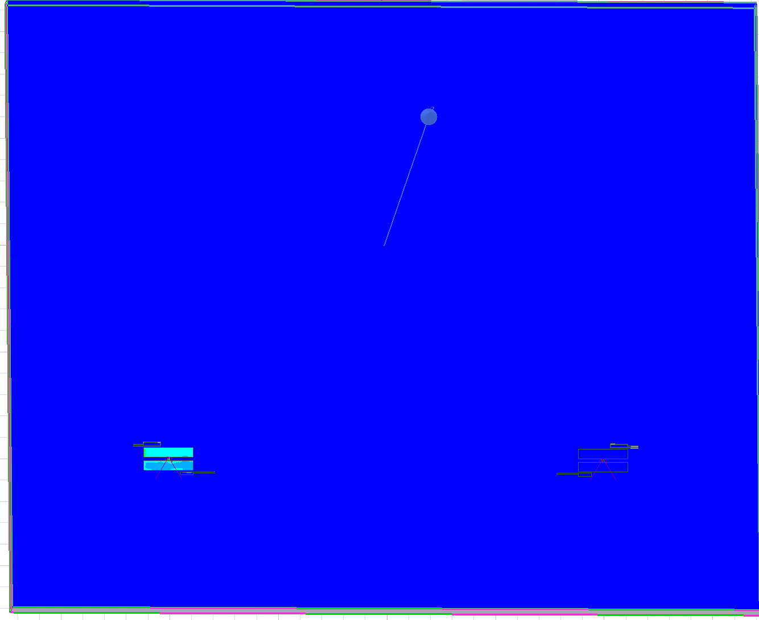
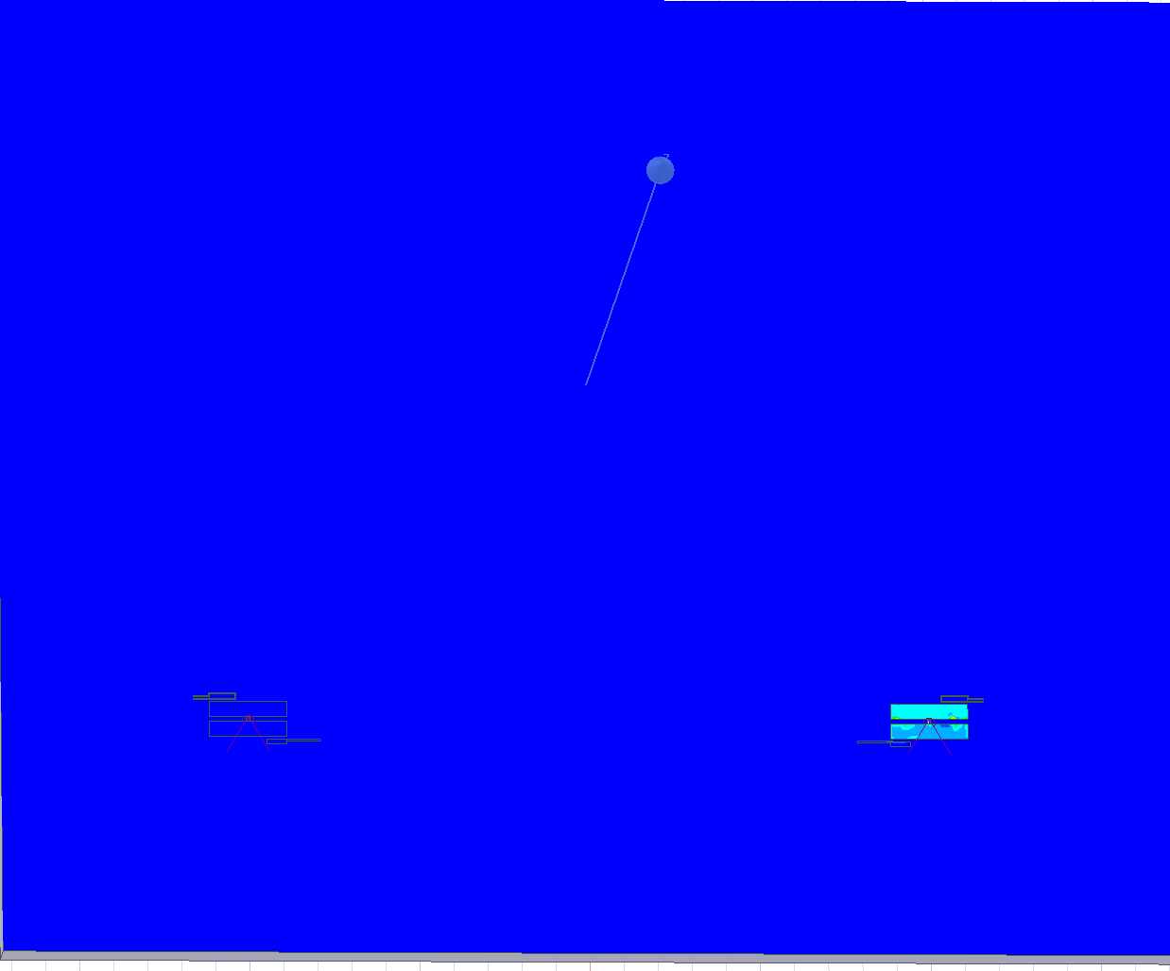
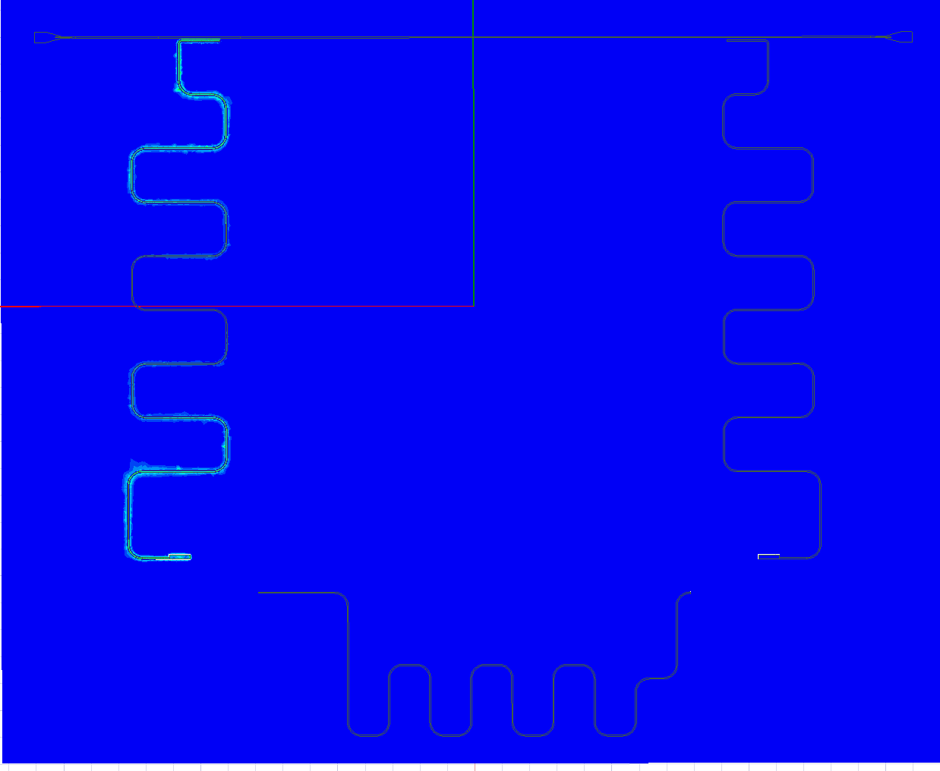
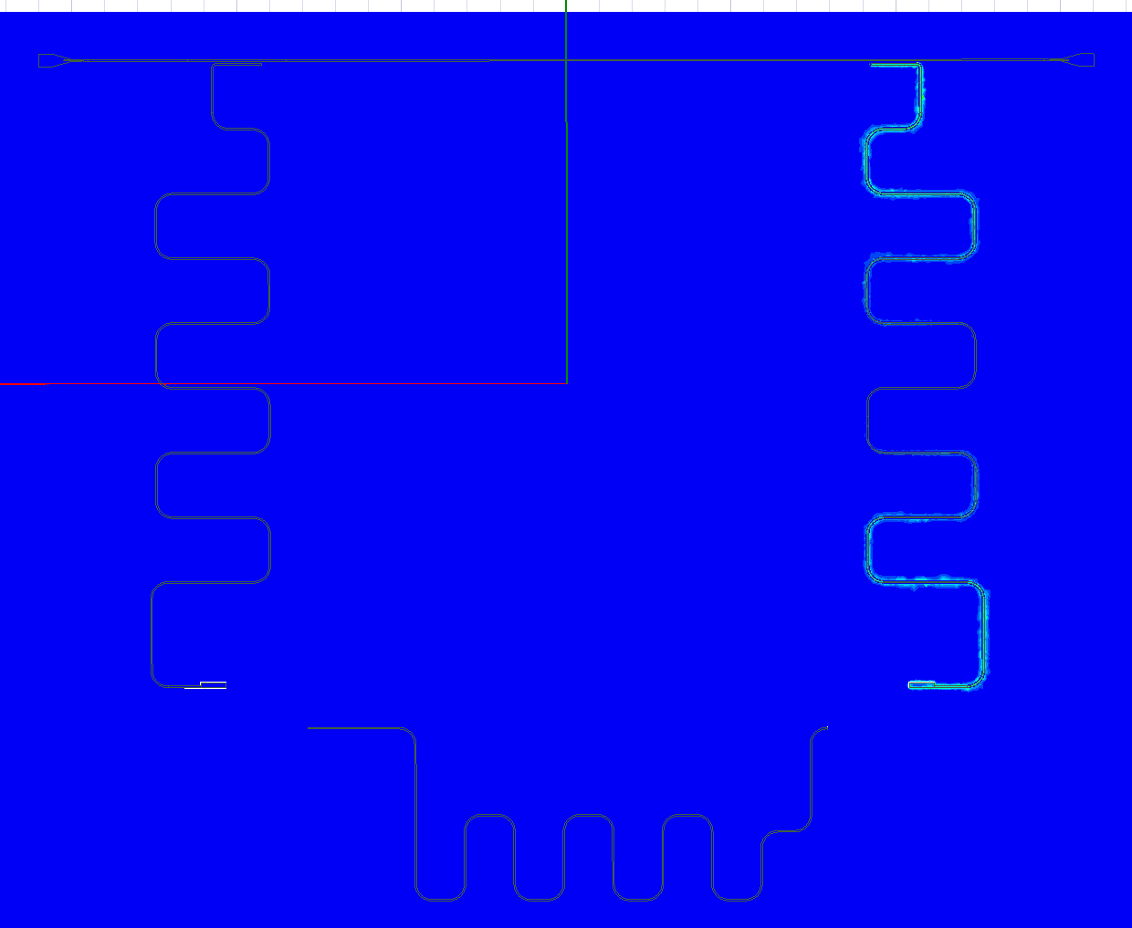
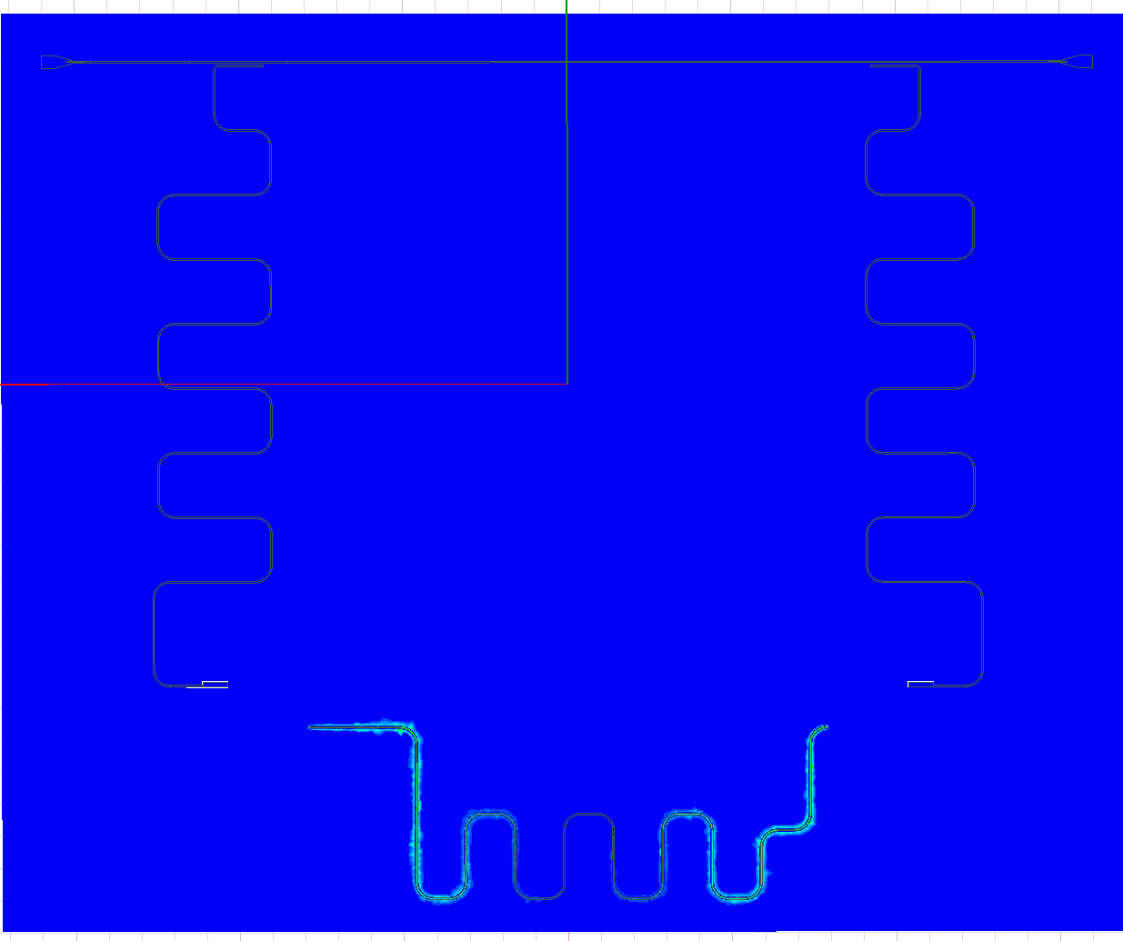
Flipchip(20um) – EPR Analysis
Flipchip(20um)
Q0 : 5.18GHz
Q1 : 5.33GHz
Rr0 : 6.72GHz
Rr1 : 6.87GHz
bus : 7.99GHz
planar
Q0 : 5.36GHz
Q1 : 5.38GHz
Rr0 : 6.82GHz
Rr1 : 6.64GHz
Bus: 7.26GHz

Slide 4
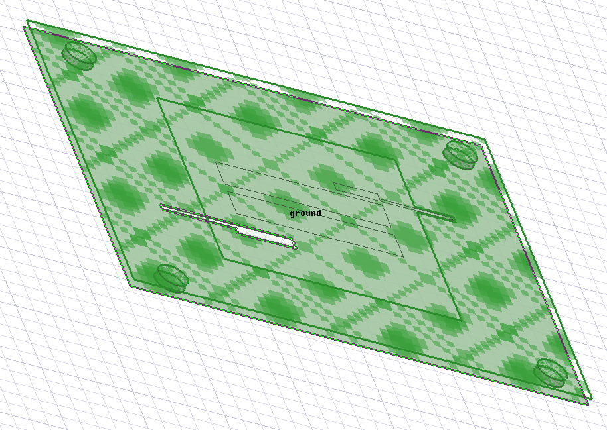
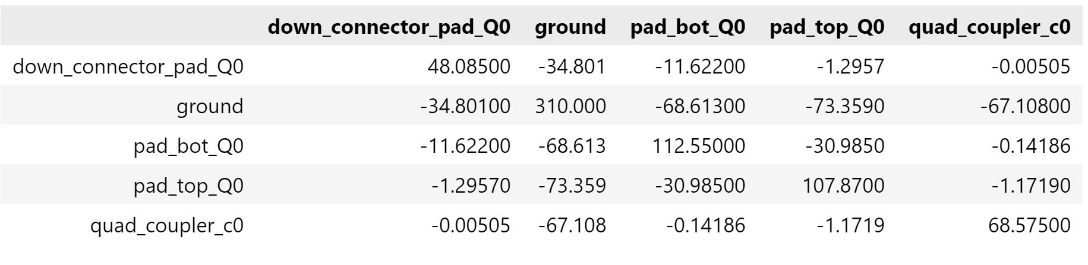
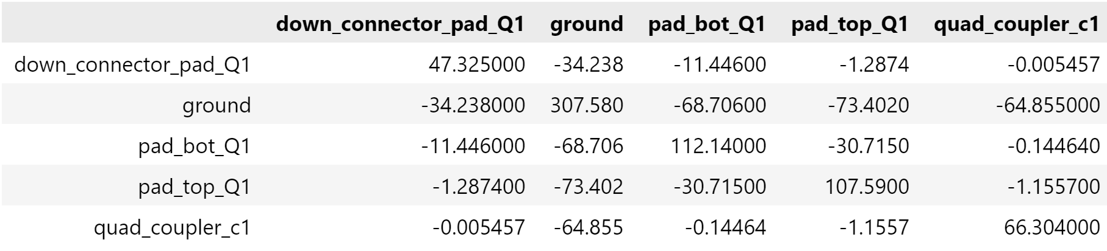
Flipchip (20um) – Capacitance Matrix

Slide 5
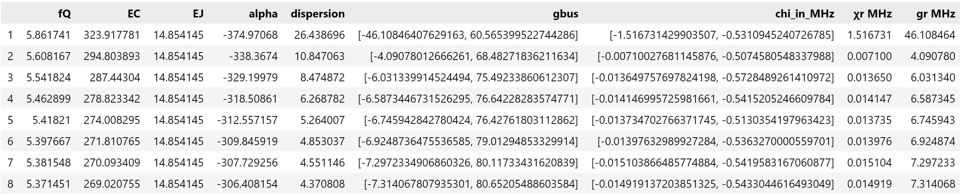
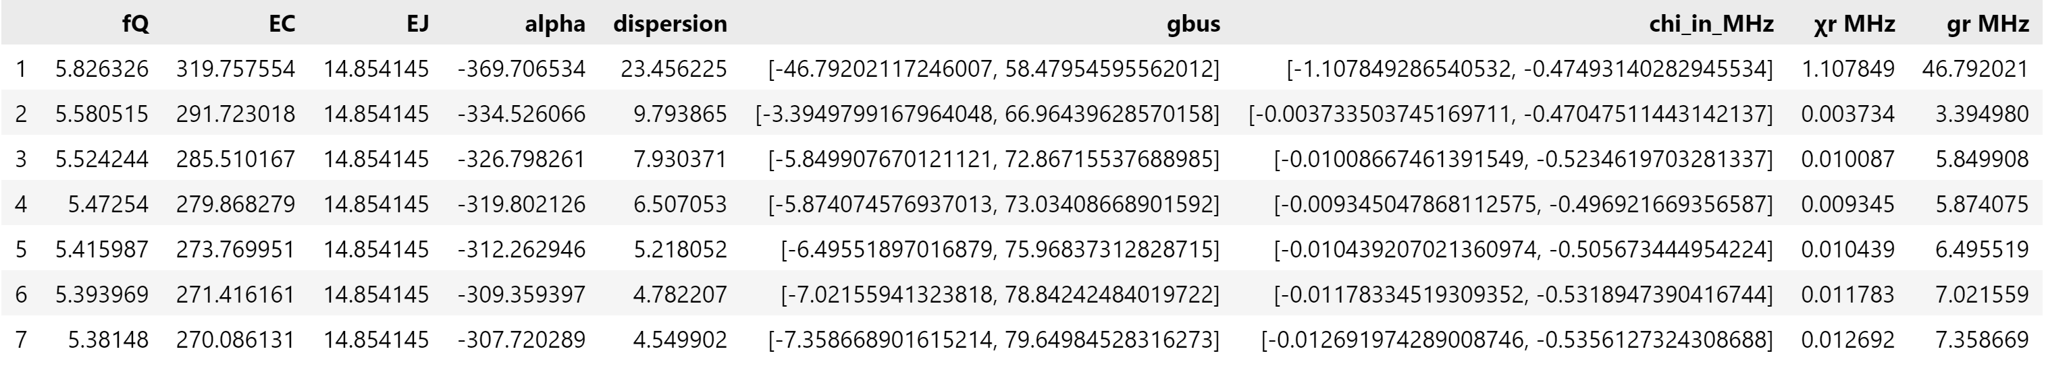
Flipchip (20um) – LOM Analysis

Slide 6
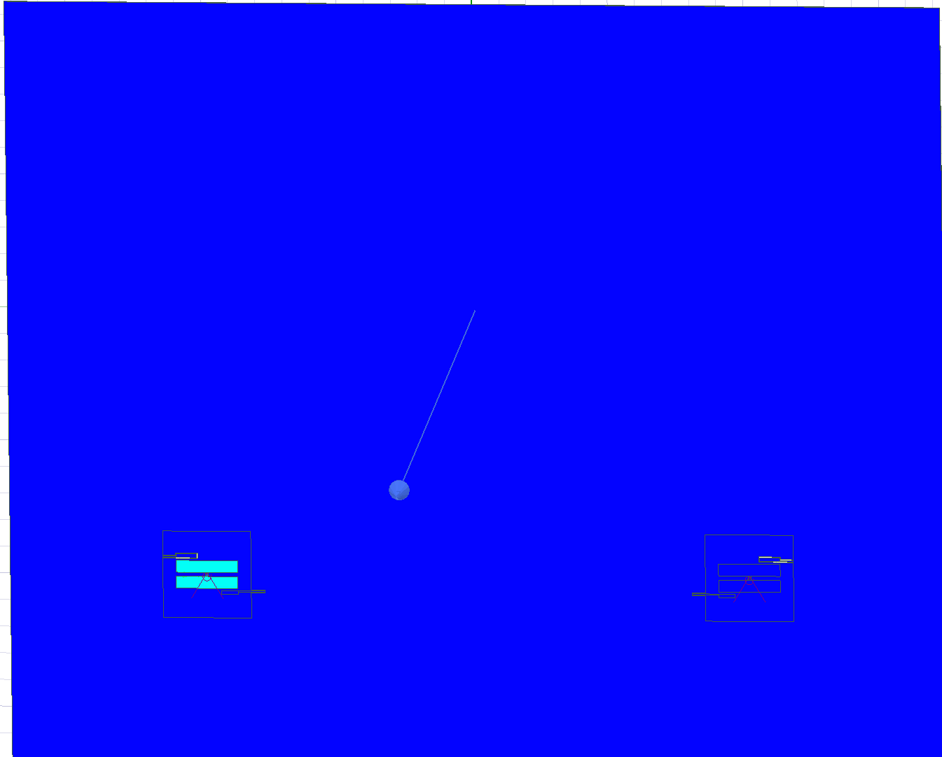
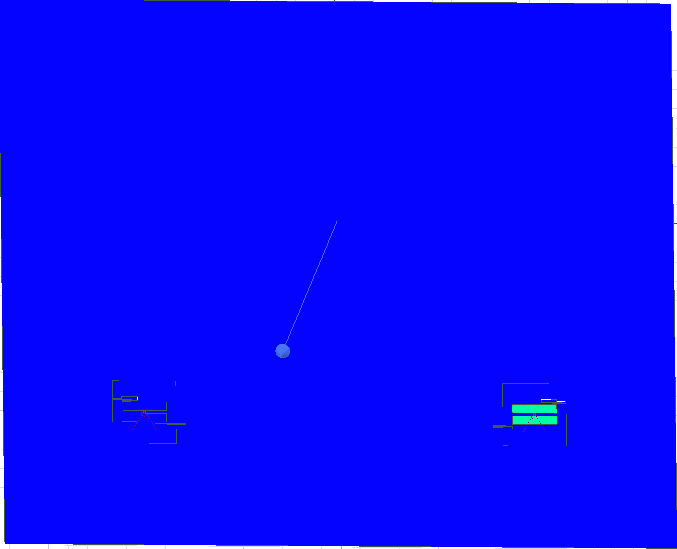
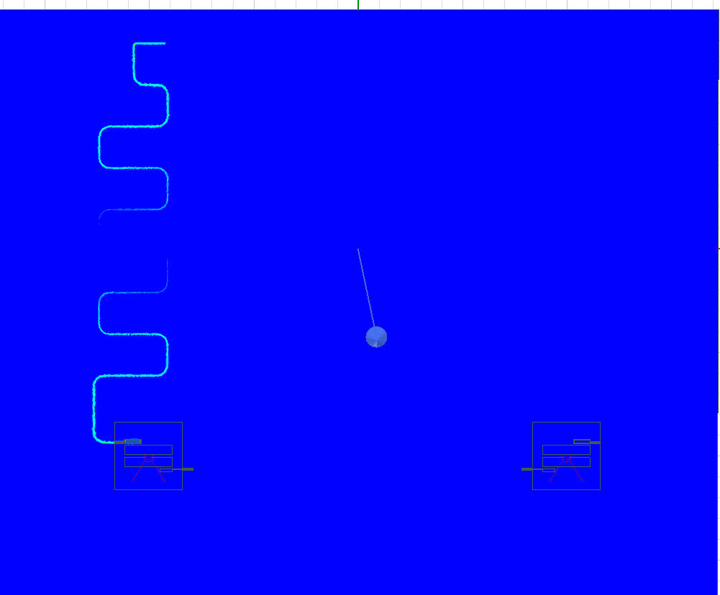
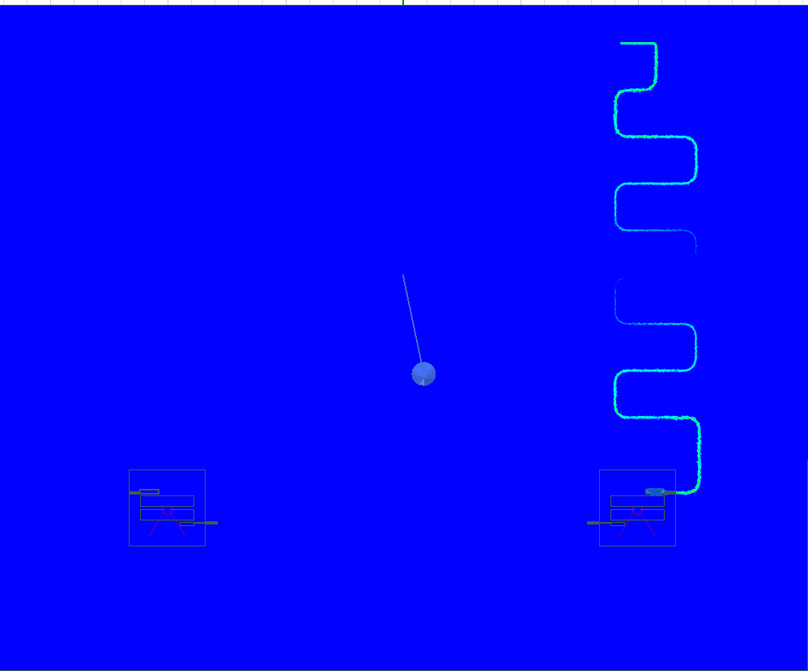
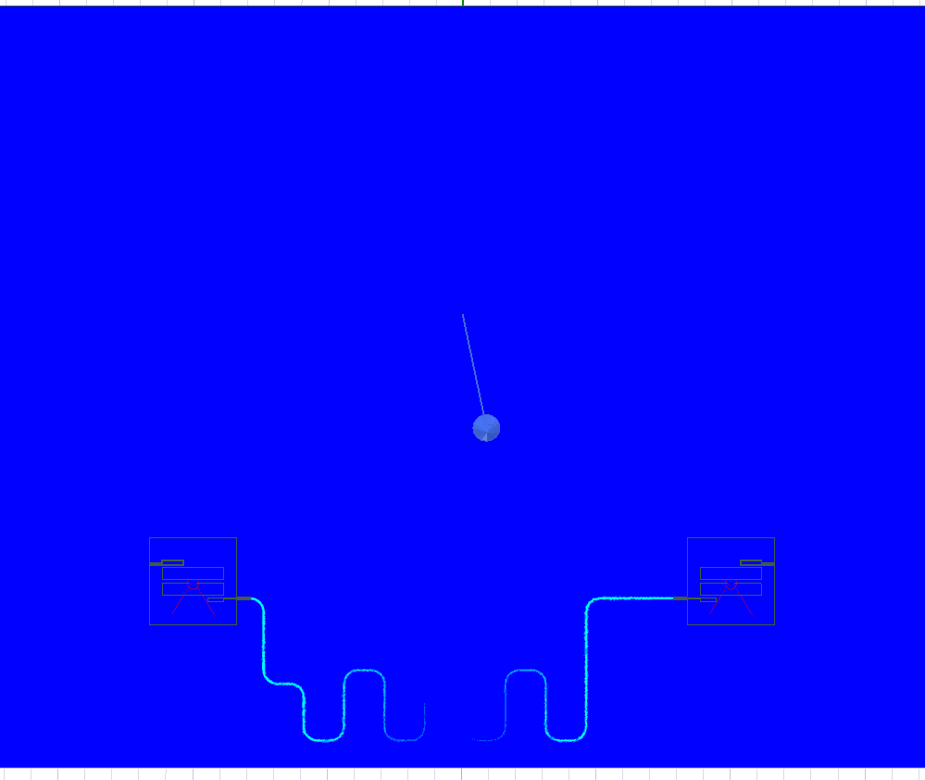
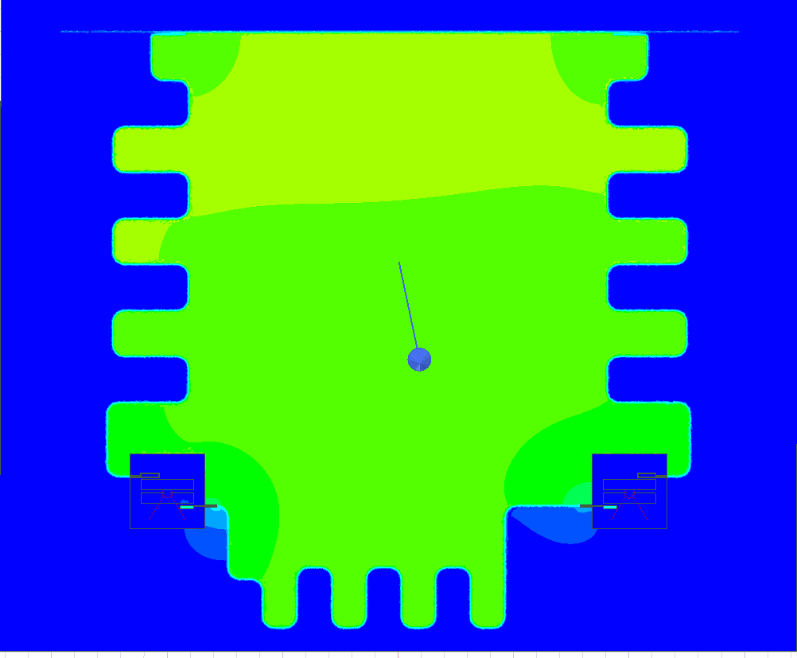
Flipchip(5um) – EPR Analysis
Flipchip(5um)
Unwanted : 6.86GHz
Q0 : 4.78GHz
Q1 : 4.81GHz
Rr0 : 7.79GHz
Rr1 : 7.60GHz
bus : 9.06GHz
Flipchip(20um)
Q0 : 5.18GHz
Q1 : 5.33GHz
Rr0 : 6.72GHz
Rr1 : 6.87GHz
bus : 7.99GHz

Slide 7
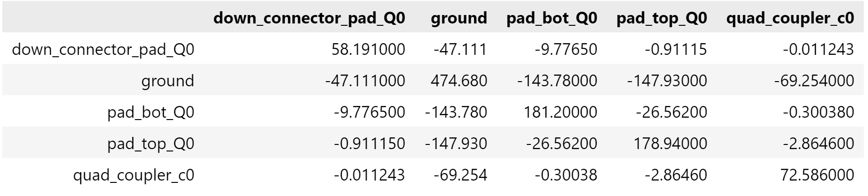
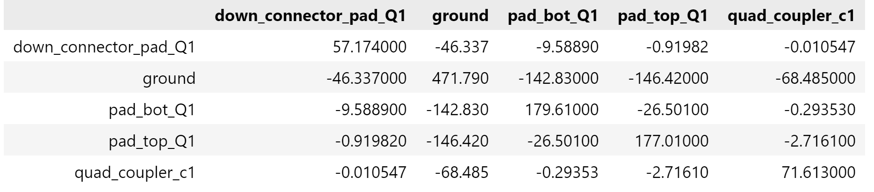
Flipchip(5um) – Capacitance matrix

Slide 8
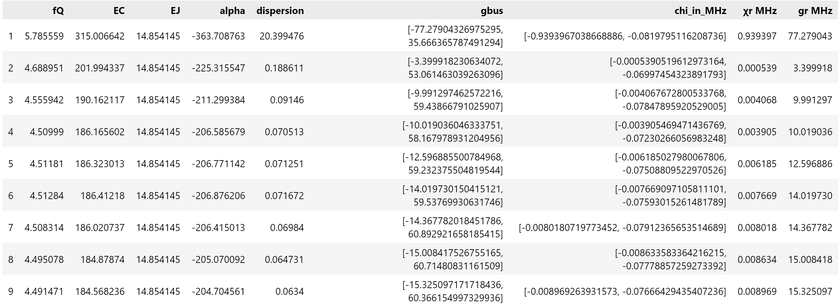
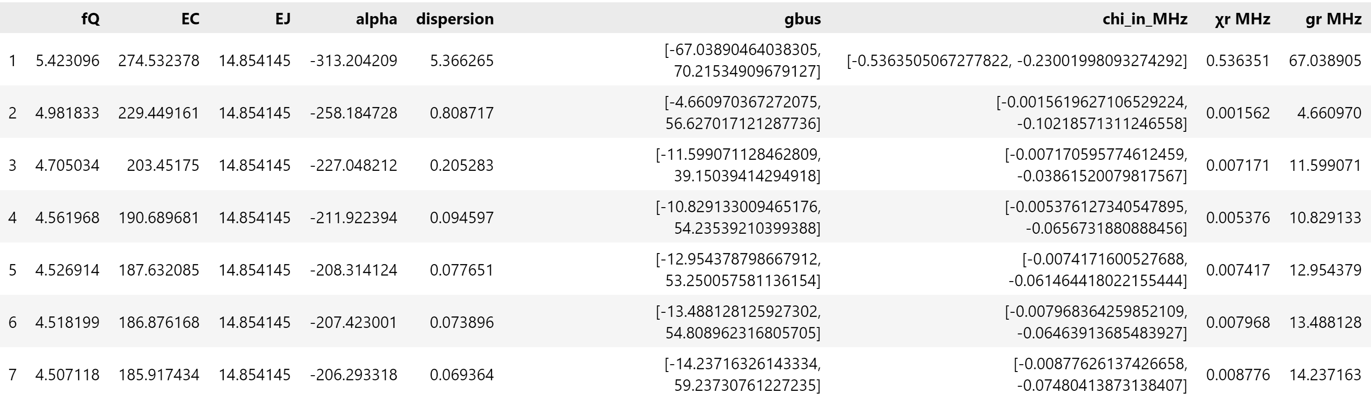
Flipchip (5um) – LOM Analysis

Slide 9
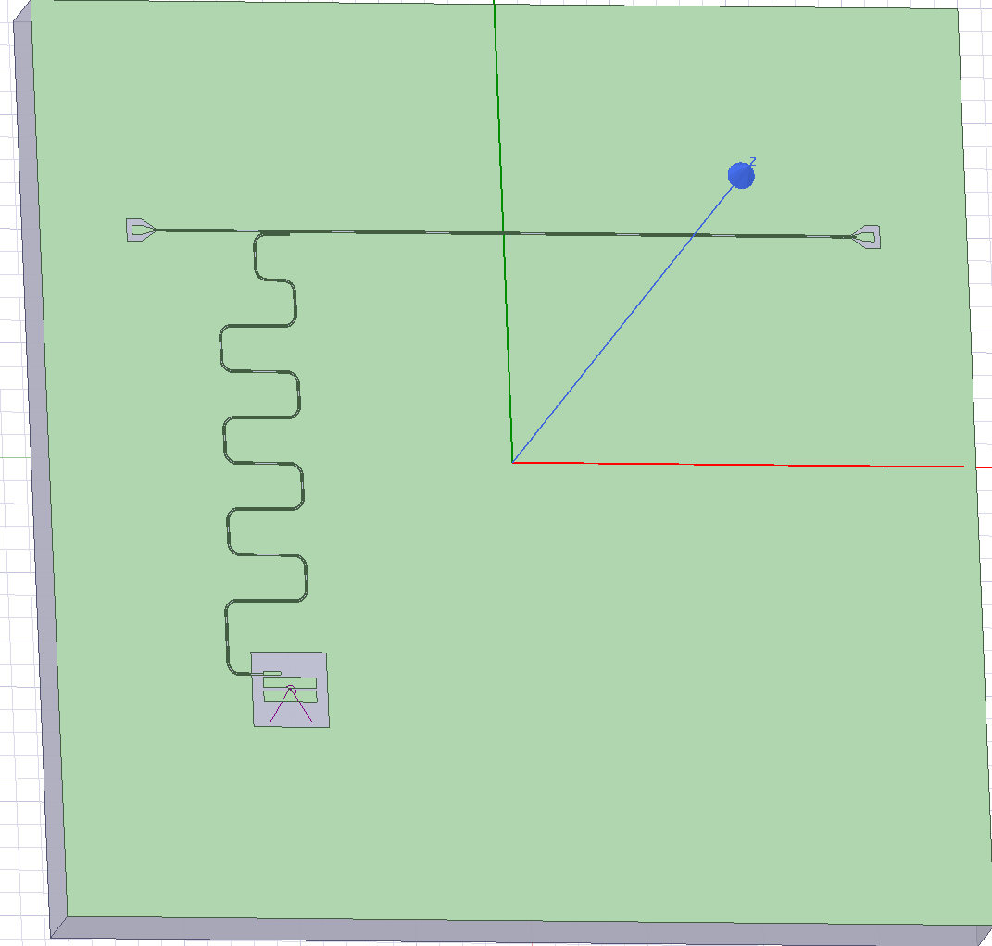
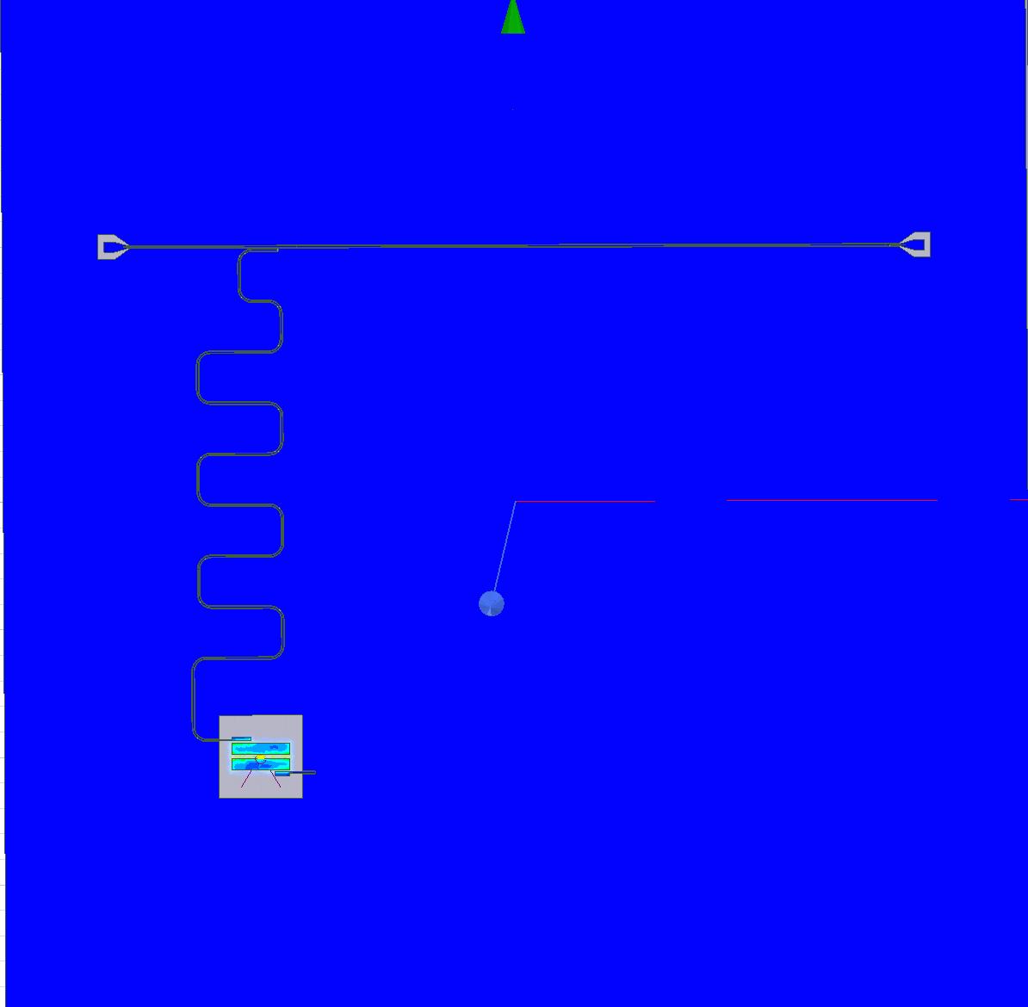
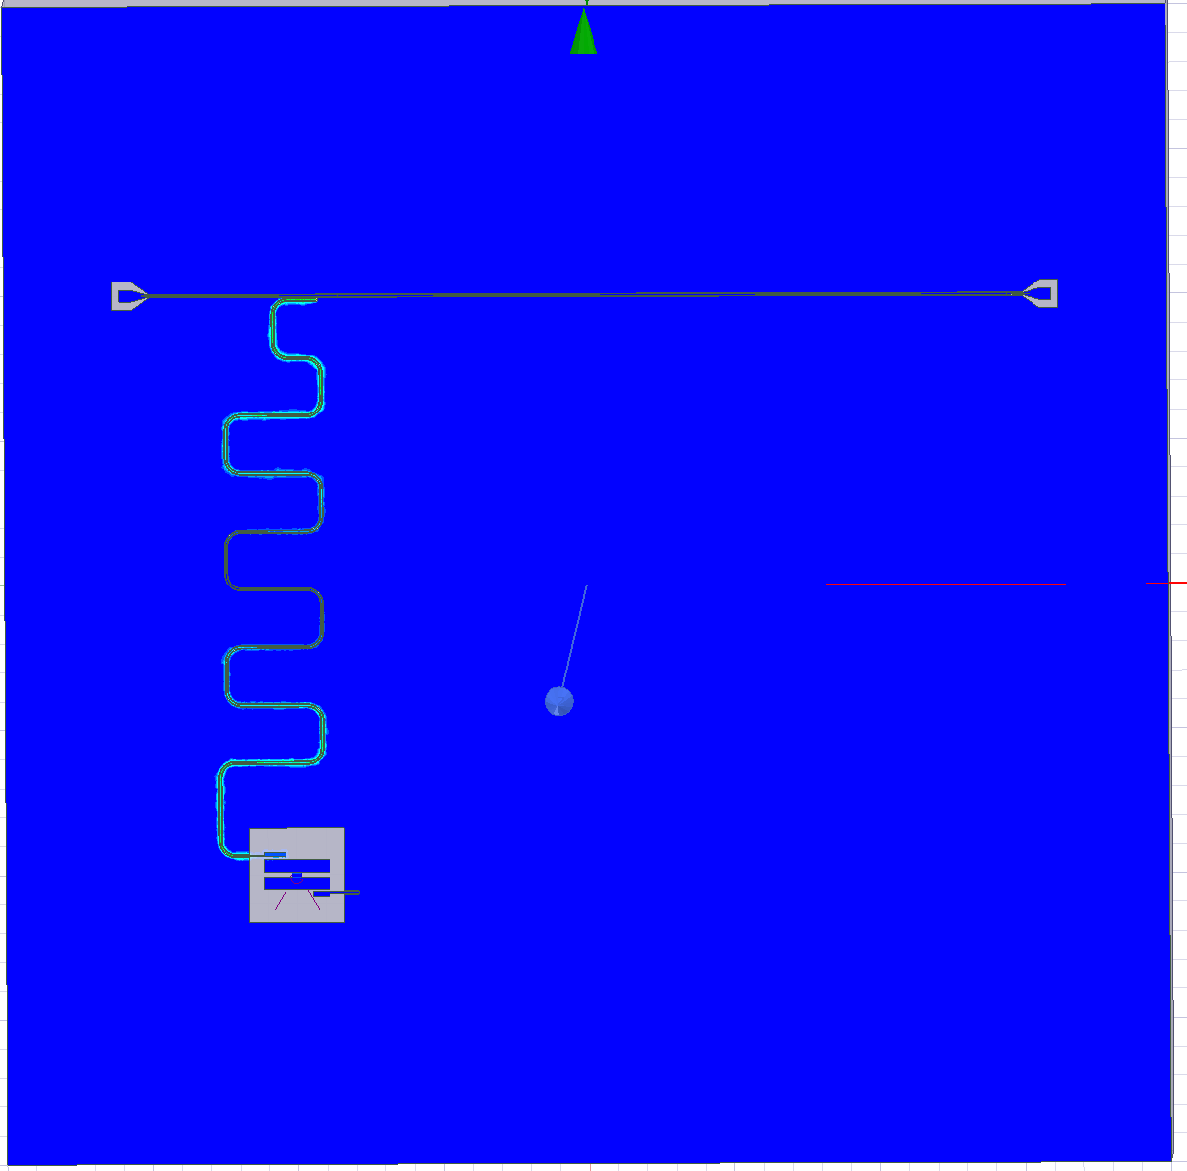
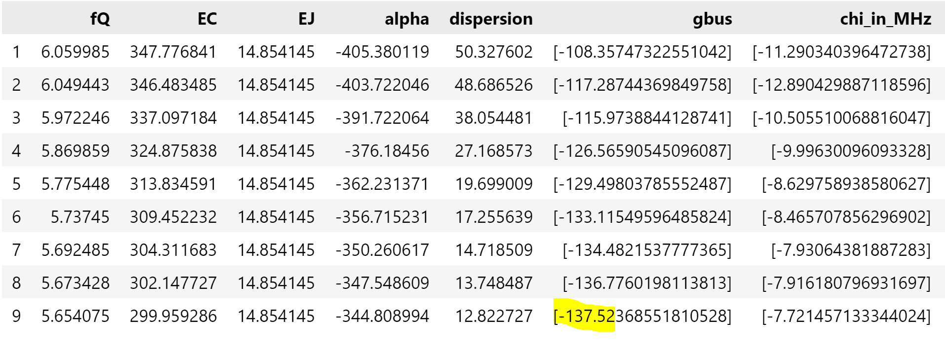
Planarchip – EPR Analysis
Q0 : 5.51GHz
RR0 : 6.80GHz

Slide 10
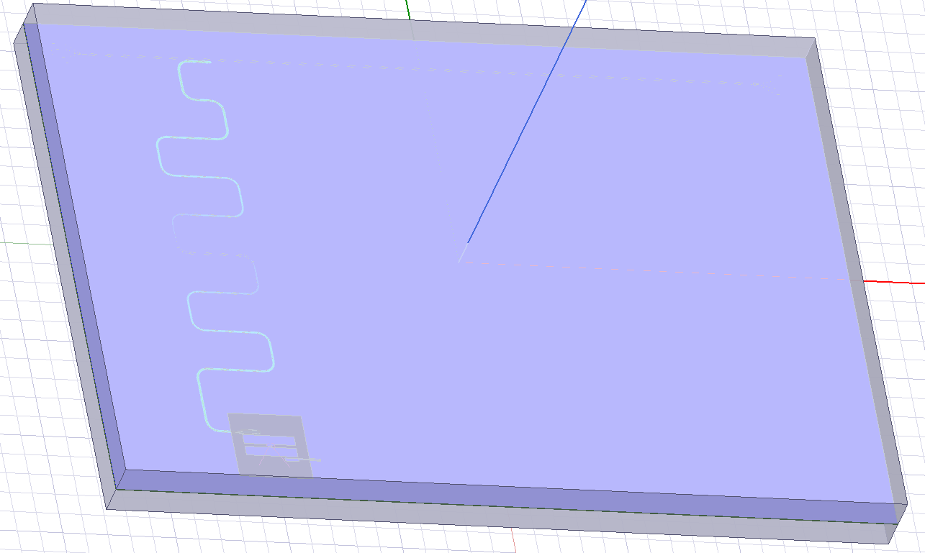
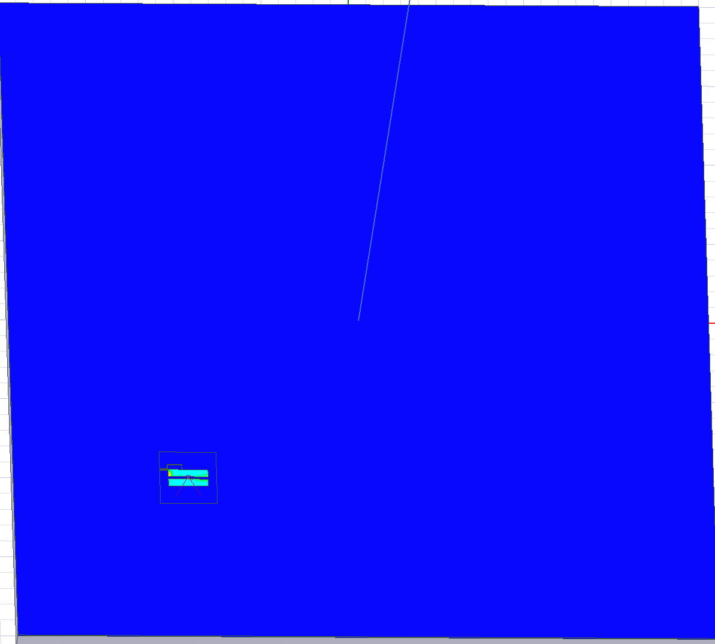
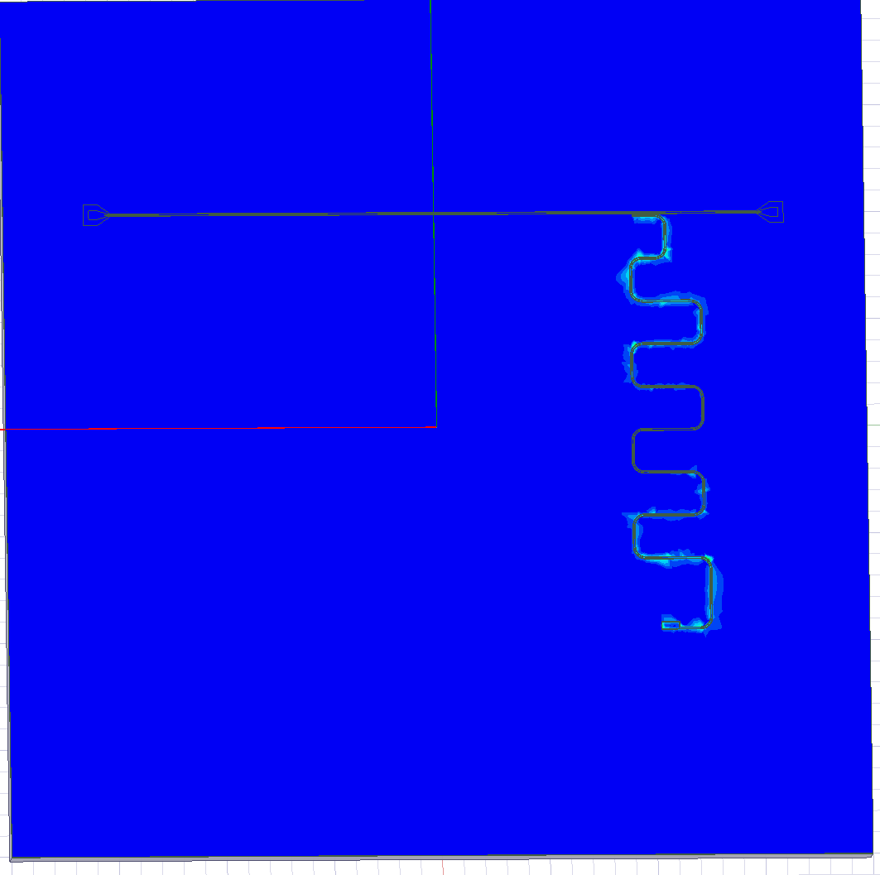
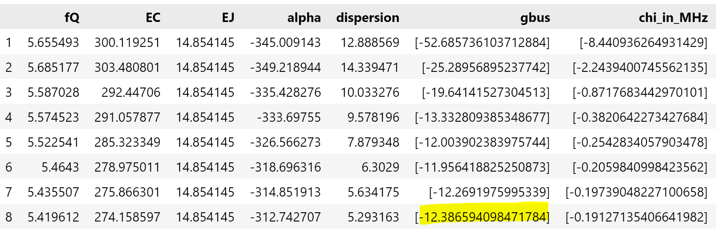
Flipchip(20um) planar design V1– EPR Analysis
Q0 : 5.49GHz
RR0 : 5.99GHz

Slide 11
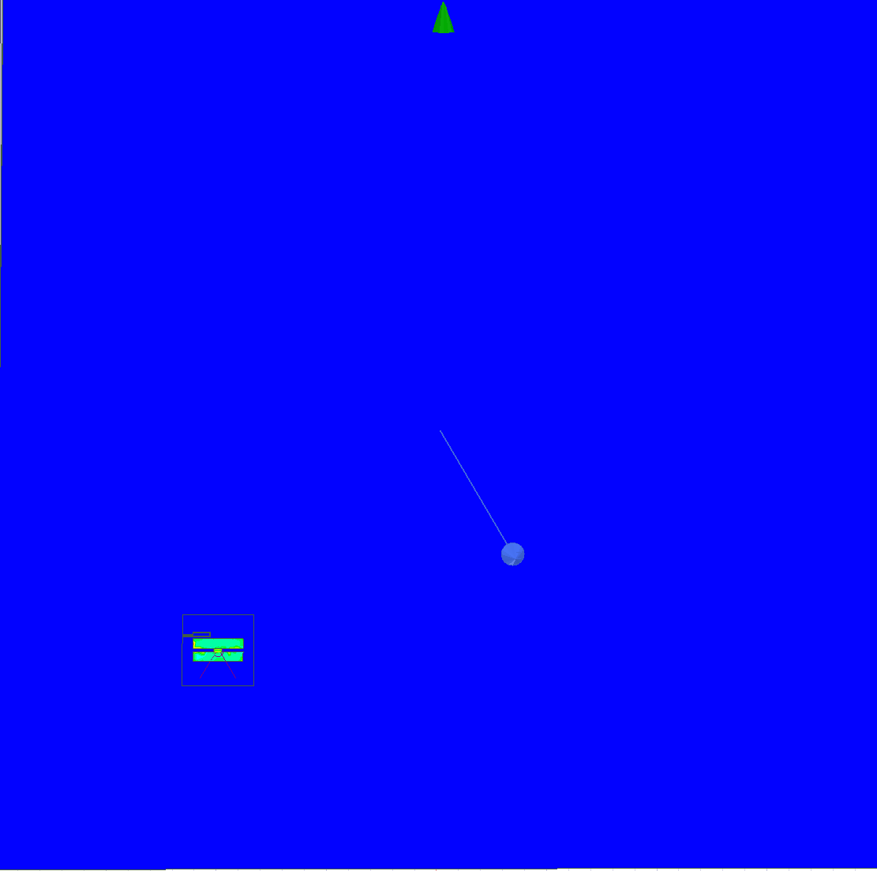
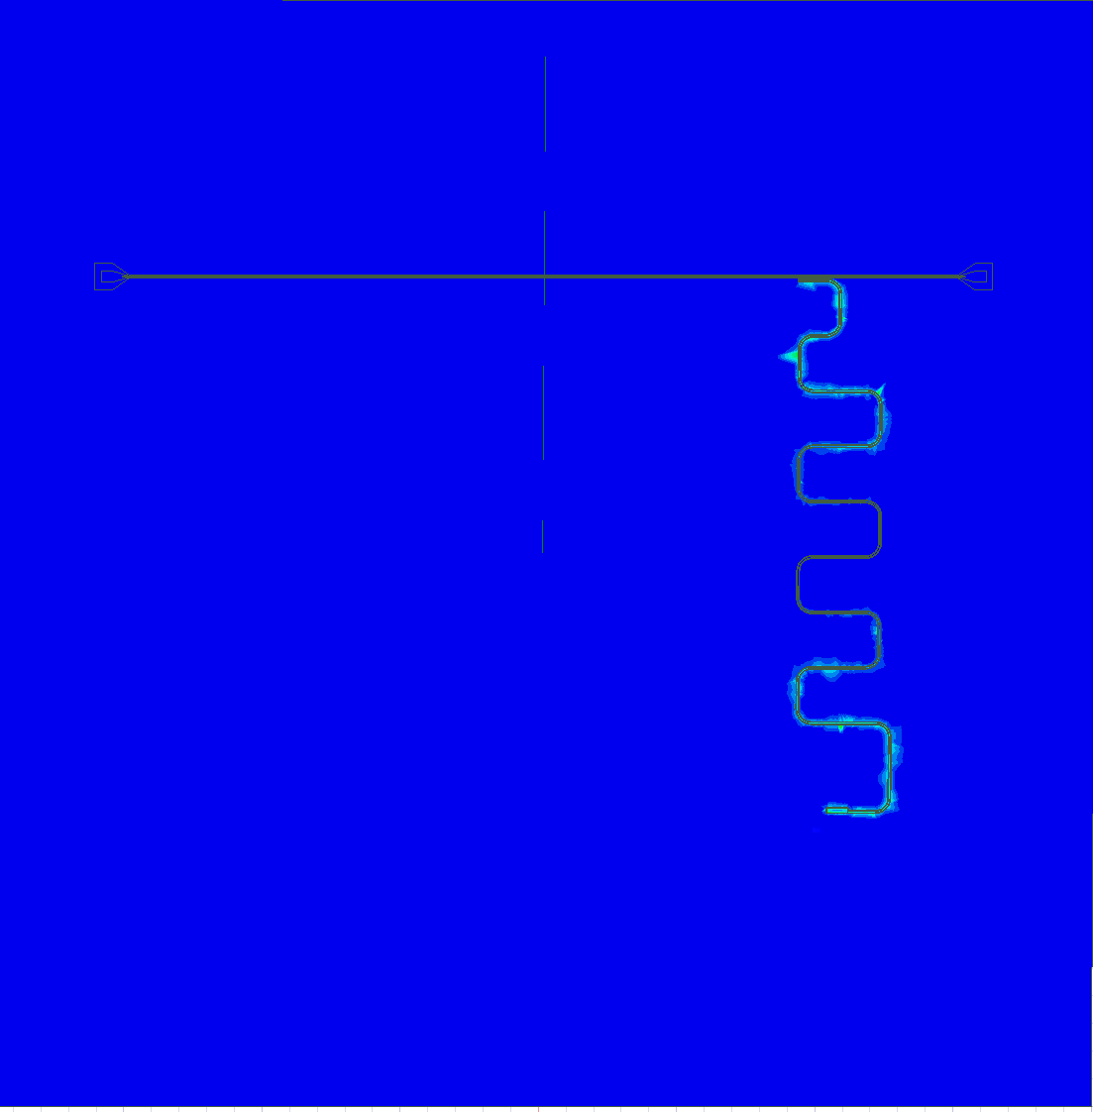
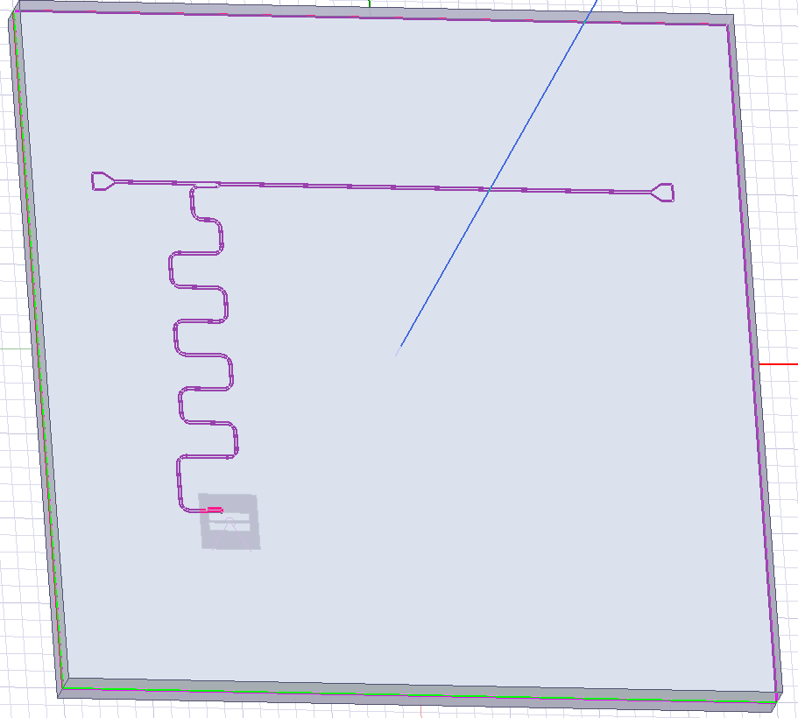
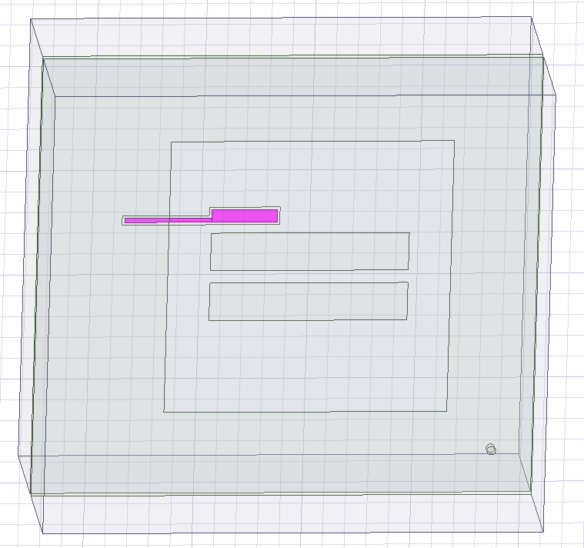
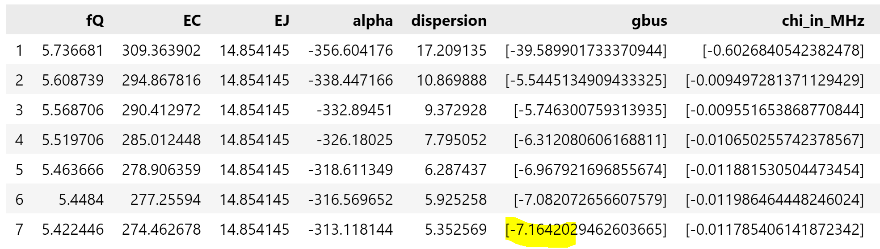
Flipchip(20um) V2 – EPR Analysis
Q0 : 5.55GHz
RR0 : 6.94GHz

Slide 12
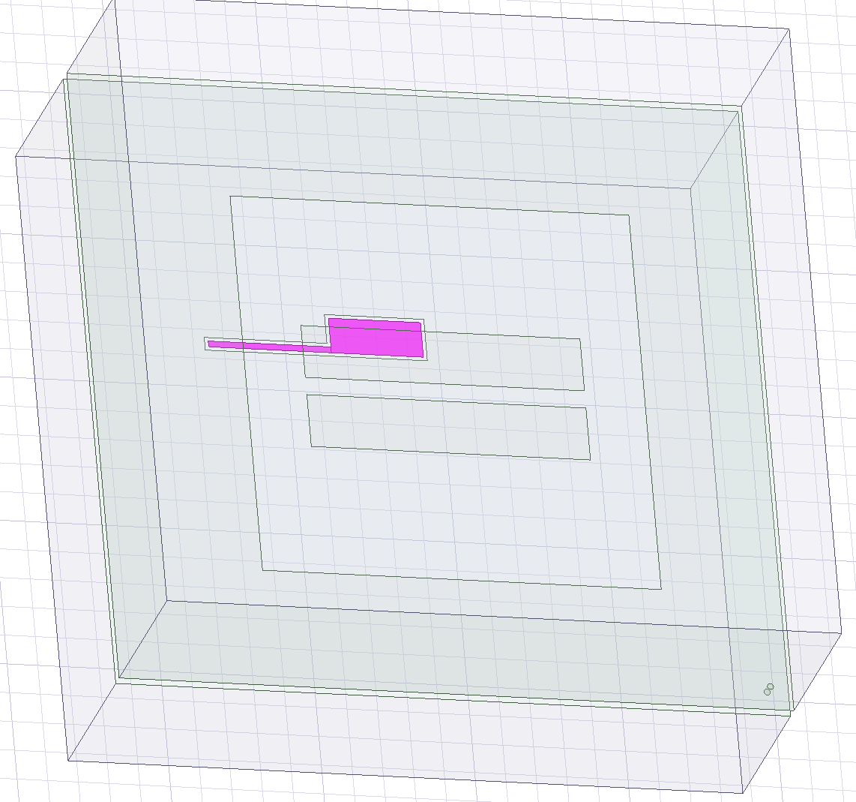
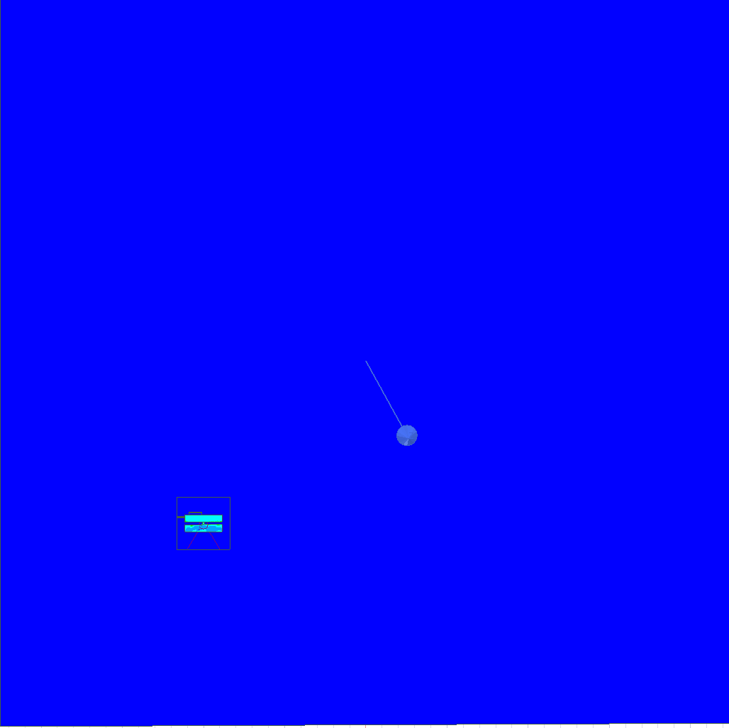
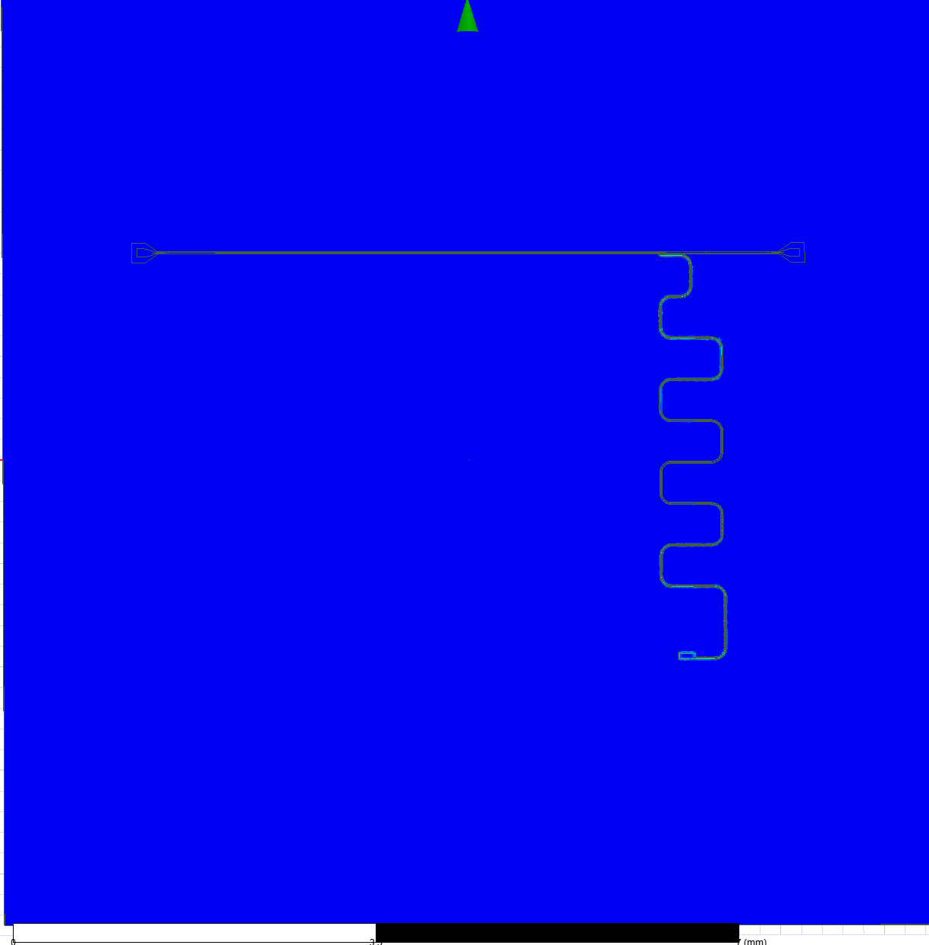
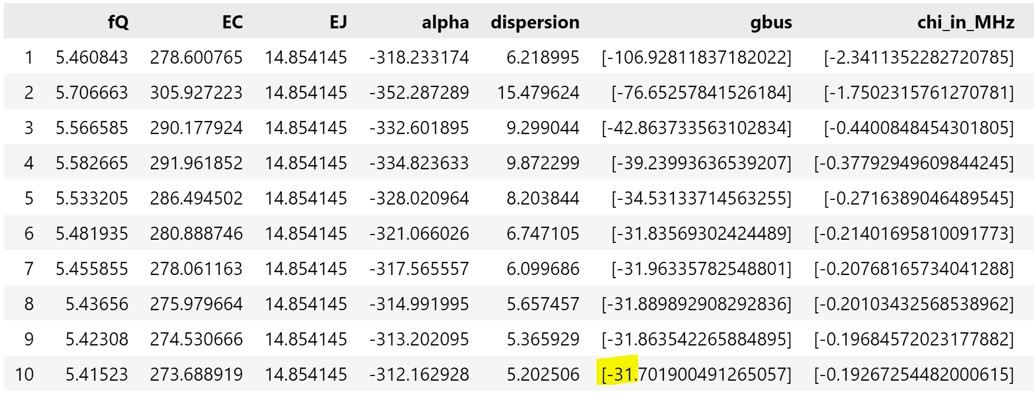
Flipchip(20um) V3– EPR Analysis
Q0 : 5.44GHz
RR0 : 7.09GHz

Slide 13
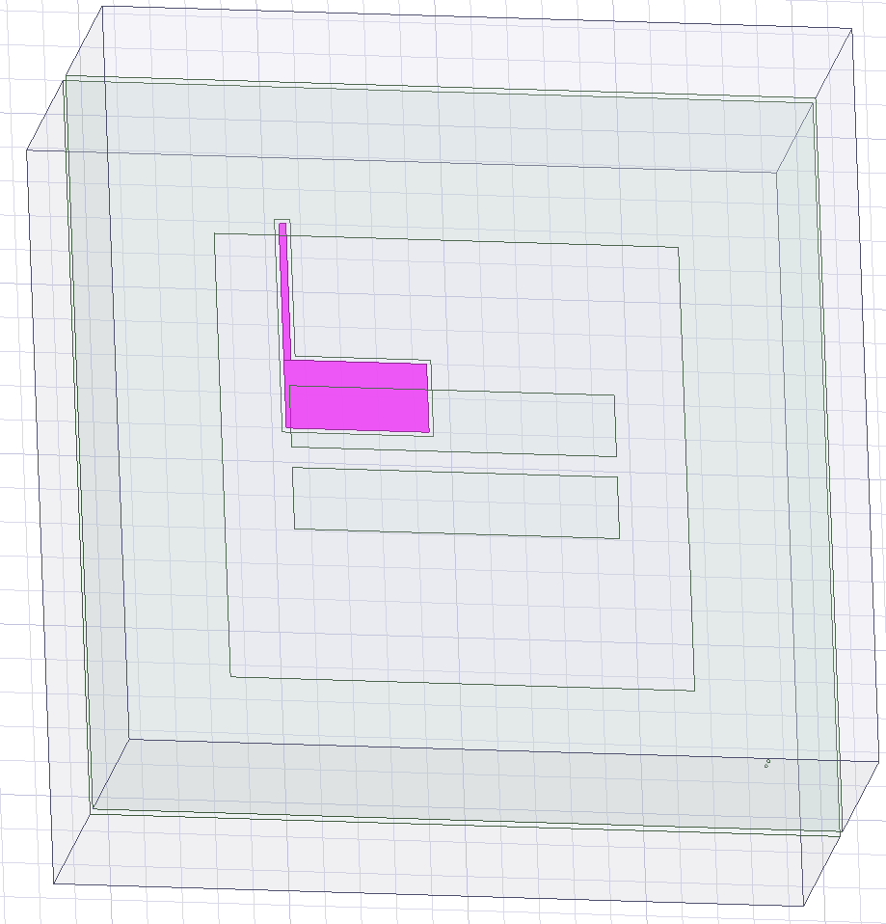
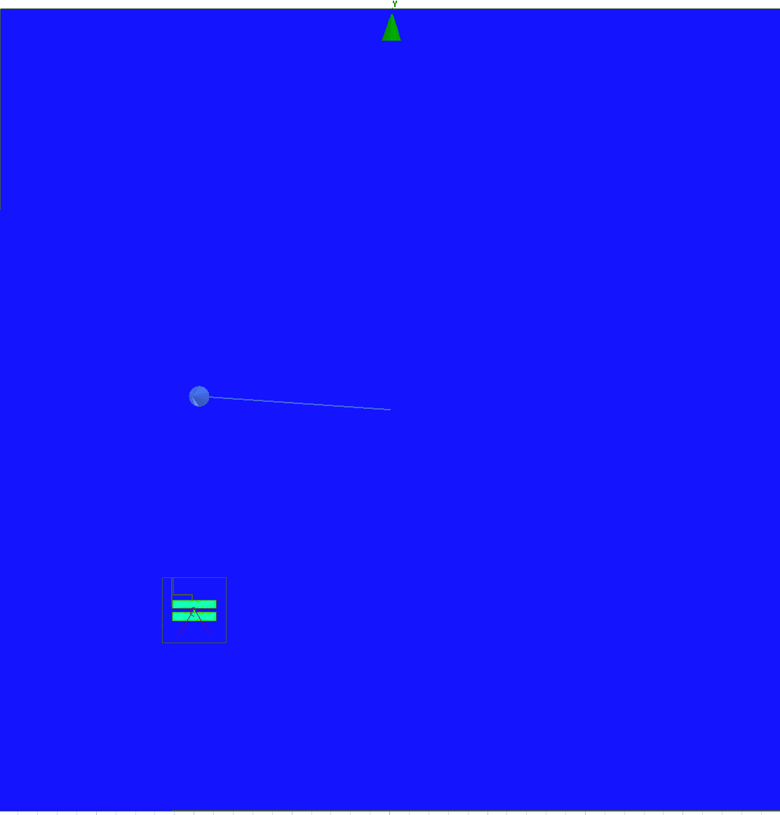


Flipchip(20um) V4 – EPR Analysis
Q0 : 5.74GHz
RR0 : 6.95GHz

Slide 14




Flipchip(20um) V5 – EPR Analysis
Q0 : 5.81GHz
RR0 : 6.88GHz

Slide 15



Flipchip(20um)V6– EPR Analysis
Q0 : 5.58GHz
RR0 : 6.58GHz

Slide 16




Flipchip(20um)V7– EPR Analysis
Q0: 5.60GHz
RR0: 6.50GHz
RR0 : 6.50GHz

Slide 17



Flipchip(20um)V8– EPR Analysis
Q0: 5.77GHz
RR0: 6.70GHz
RR0 : 6.50GHz

Slide 18




Flipchip(20um)V9– EPR Analysis
Q0: 5.63GHz
RR0: 6.69GHz

Slide 19



Flipchip(20um)V10– EPR Analysis
Q0: 5.59GHz
RR0: 6.84GHz

Slide 20




Flipchip(20um)V11– EPR Analysis
Q0: 5.52GHz
RR0: 6.86GHz

Slide 22
 | Design change | Qubit (GHz) | Resonator(GHz) | Coupling g (MHz)
Planar chip |  | 5.51 | 6.80 | 137
V1_20um | Planar chip design same | 5.49 | 5.99 | 12
V2_20um | Resonator length | 5.55 | 6.94 | 7
V3_20um | Coupler position | 5.44 | 7.09 | 31
V4~V9_20um | Coupler size, Resonator length | 5.63 | 6.69 | 138
V10_20um | Transmon pad gap | 5.59 | 6.82 | 129
V11_20um | Transmon pad gap, Coupler position | 5.52 (0.2%) | 6.86 (0.9%) | 133 (2.9%)
V11_20um | 5.52 | 6.86 | 133
V1(11)_12um | 5.34 | 7.00 | 209
V1(11)_5um | 4.58 | 7.34 | 414
Planar | 5.51 | 6.80 | 137
V1_5um | 4.44 | 6.82 | 18
V1_6um |  |  | 13
V1_7um | 4.80 | 6.78 | 11
V1_8um | 4.93 | 6.74 | 10
V1_12um | 6.99 | 10.39 | 13
V1_20um | 5.49 | 5.99 | 12

